Slide 1
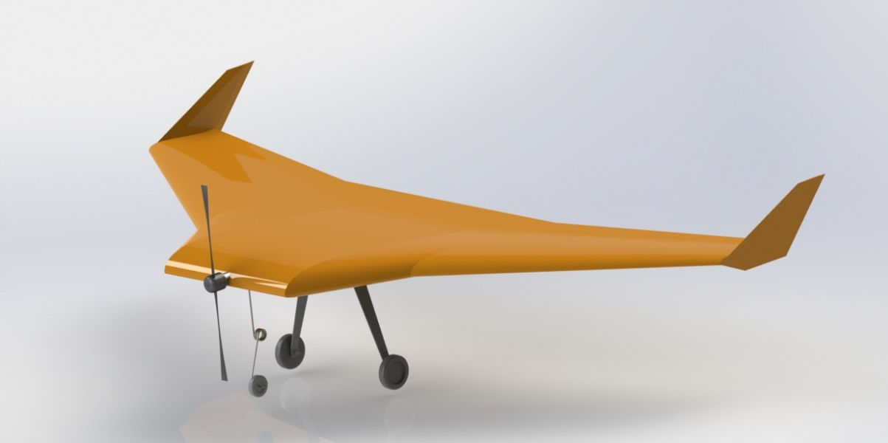


AER406 Aircraft Design Final Design Review
Presented by Team Flying penguin
Shirley Silin Yang - Aerodynamics
David Yilun Wu - Stability
Eric Cheng Lu - Performance
Thomas Siu Hong Leung - Structures
Notes:
0 minutes

Slide 2
Overview
High Level Design
Tradeoffs
Preliminary Design
Performance
Notes:
0 minutes

Slide 3


High Level Design

Slide 4
Problem Statement
“The objective of this design project is to design, build and fly a radio-controlled model aircraft that maximizes the score of a prescribed score function “
Notes:
0.25 minutes

Slide 5
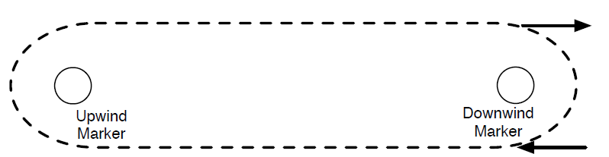
Requirements & Constraints
The aircraft MUST:
Demonstrate stability in the zip-line test
Take-off from runway under its own power
Complete the above circuit at least once without any cargo on-board
Complete the above circuit on a level-flight
Carry 100 – 1200 cargo units
Accommodate flight data recorder and instruments
The aircraft SHOULD:
Carry an on-board video-recorder
Notes:
[Lap 4]
0.5 minutes

Slide 6
Design Drivers
Ease of Modelling & Analysis
Increase the validity of the aerodynamic model
Reduce uncertainty in the aerodynamics calculations
Reduce calculation lead time if design parameter(s) need to be modified, for faster turnover rate
Ease of Construction & Reparation
High tolerance design
Design Simplicity
May compromise A/C weight and performance, but ensures successful flight
Notes:
0.5 minute
Lap 5

Slide 7
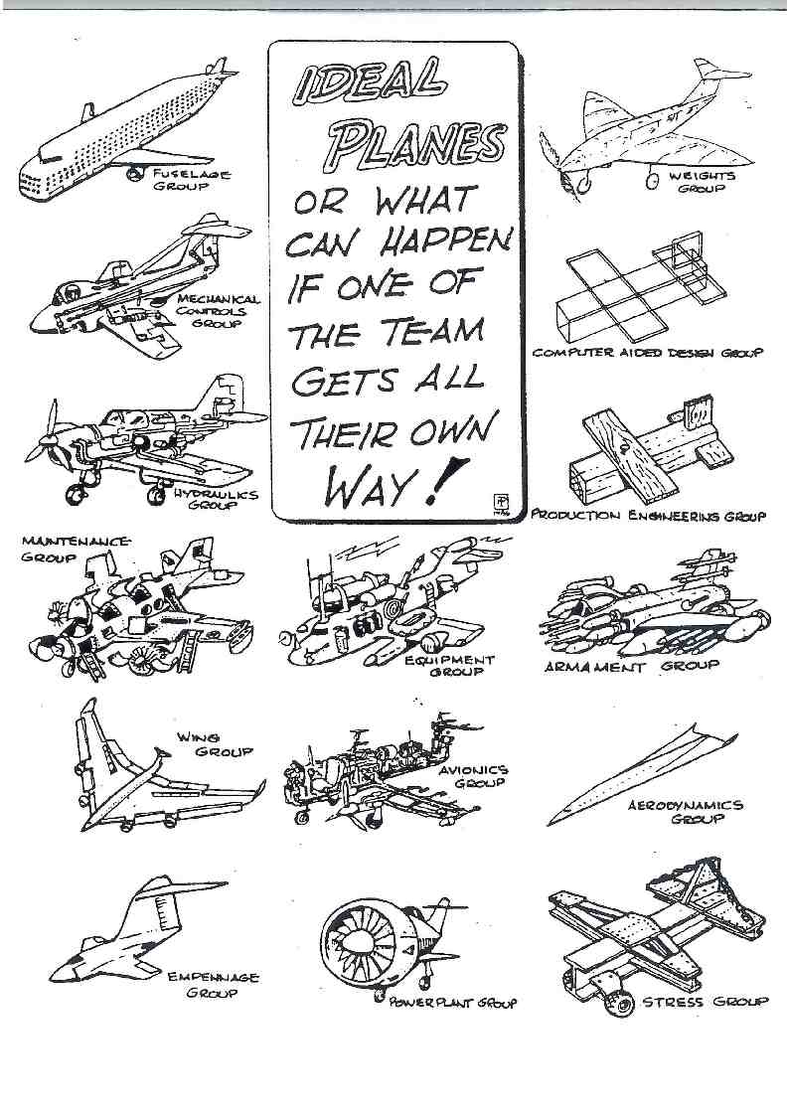
Design Process
Raymer’s Design Process
Conceptual Design: Configuration arrangement, size, weight and performance
Preliminary Design: aerodynamics, propulsion, structures, stability and control subsystems
Detailed Design: fabrication and manufacturing
Basic Principles of Aircraft Design
Aerodynamic and stability parameters
“Rules of Thumbs”
Previous design
CAD Modelling & Analysis Tools
SOLIDWORKS
XFLR5
MATLAB
[*]
[*] Aviator magazine
Notes:
0.5 minute

Slide 8
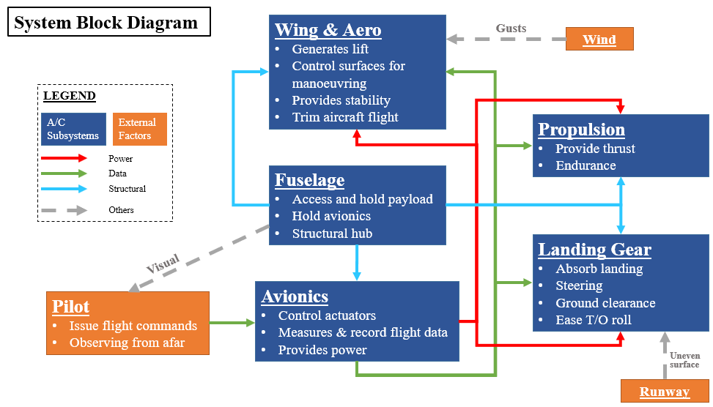
System Block Diagram
Notes:
1 minute

Slide 9
Scoring Analysis
Ping-pong vs. Golf vs. Tennis ?
 | Ping-pong | Golf | Tennis
Mass (g) | 2.5 | 45.5 | 59
Score | 10 | 50 | 120
# balls (Cargo 1200) | 120 | 24 | 10
Payload mass (g) | 300 | 1092 | 590
Payload Frac = 0.3 (from past AER406 designs)
A/C Full mass (g) | 1000 | 3640 | 1970
A/C Empty mass (g) | 700 | 2550 | 1380
Kit mass = 323.5g ; Landing Gear + propeller = 275g + 55 = 330g (^) Conservative estimation (+ bonding materials) = 654g x 1.1 = 719g
Allowable wing / structural weight (g) | -19 | 1831 | 661
(^): Weight of the landing gear is mainly determined by the ground clearance of the propeller, less by a/c mass. LG sized for 9x6 tall, but similar for other prop.
Notes:
1 minute

Slide 10
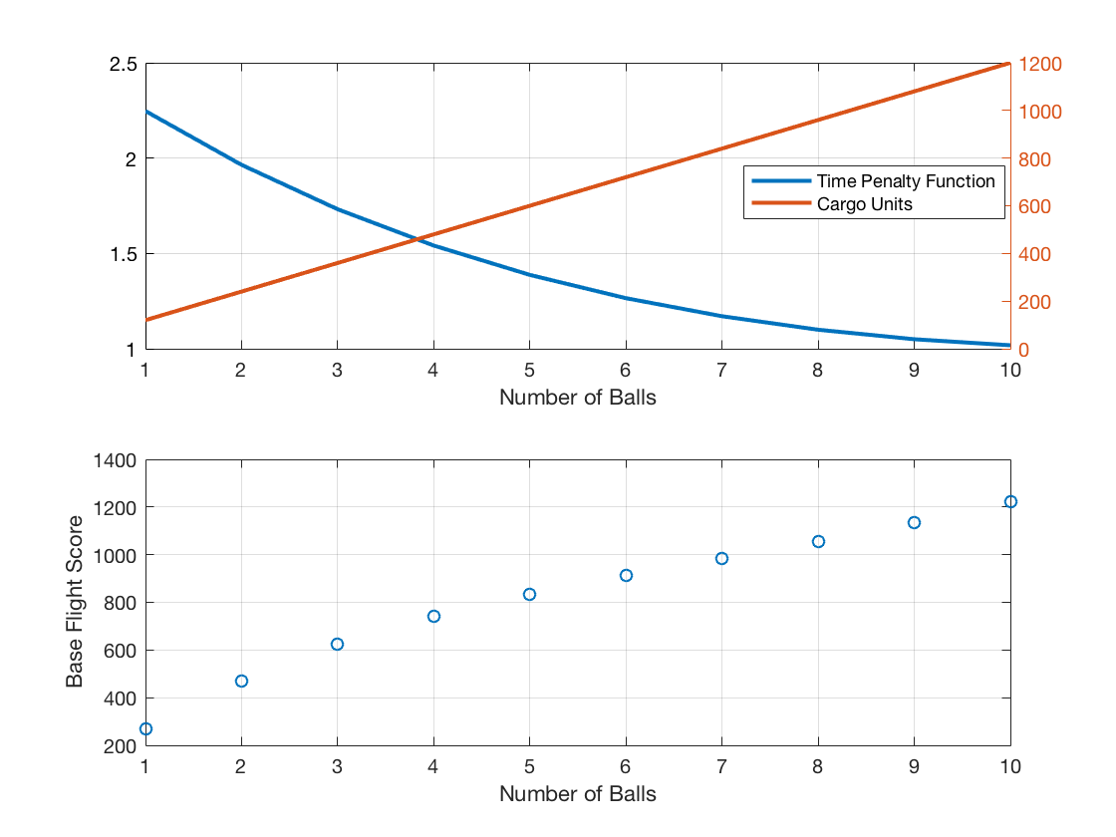
Scoring Analysis
Flight Score
= Cargo Units × f(t) × PF × TB × CB × STB + VB
= Cargo Units × f(t) × 0.3 × 1.25 × 2 × 1.2 + 200
Conclusion:
Fly with maximum payload. (i.e. 10 tennis balls)
Notes:
1 minute

Slide 11
Tradeoff Studies
Notes:
( 5 minute mark)

Slide 12
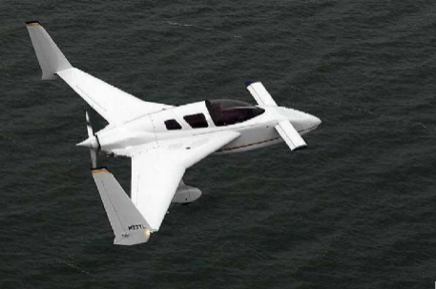
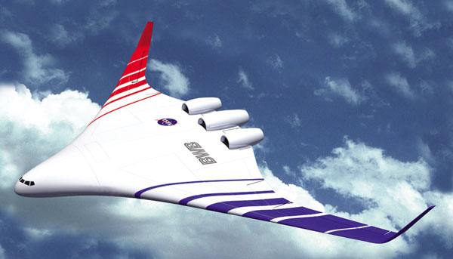
Tradeoff - A/C Configuration
Canard
Less constrained in wing design
Canard makes designing a stable a/c easier
Fuselage and interface. More parts to construct.
Fuselage does not generate lift only drag.
BWB
Just-a-wing design
Airfoil/ wing calculation governs most part of performance & stability
Inefficient reflex airfoil needed.
High quality construction needed.
A/C stability highly sensitive to CG positi
Conclusion → BWB
More accurate aerodynamic prediction on performance
Similar difficulty in construction
More accurate manufacturing vs more parts to manufacture → reduce part to reduce lead time
Similar difficulty in designing, but BWB score multiplier is 11% higher
Notes:
0.75 minute

Slide 13
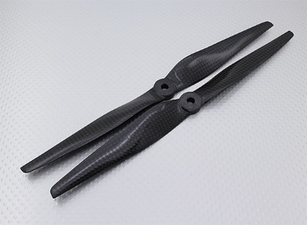
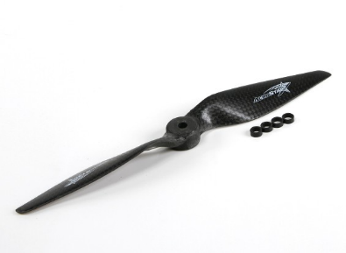
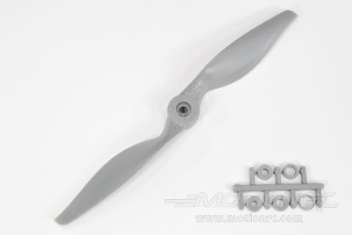
Tradeoff - Propeller Selection
10x5
Provide the most thrust at takeoff
Lowest pitch speed
Smallest upper bound on the cruise speed
Require long landing gears
9x6
Moderate thrust at takeoff
Moderate pitch speed
Moderate upper bound on the cruise speed
8x8
Highest pitch speed
Largest upper bound on the cruise speed
Provide the least thrust at takeoff
Propeller stall at lowest speed
Conclusion → 9x6
Sufficient thrust at cruise speed
Achievable takeoff bonus
Acceptable motor efficiency
Notes:
0.75 minute

Slide 14
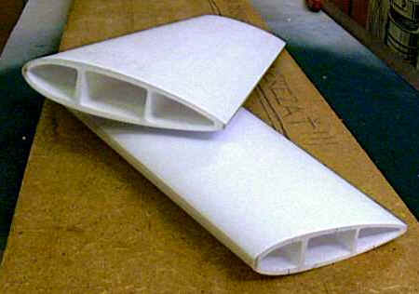
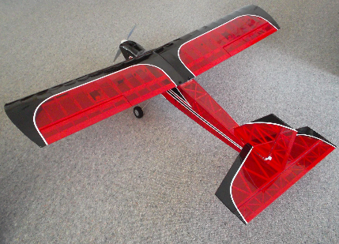
Tradeoff – Construction Method
Foam core
Easy to manufacture, in bulk
Enable quick iterative designing
Limited complexity of planform design
Difficult to hollow out
Less precise, due to form-cutter
Uncertainty in bonding foam pieces
Ribs-and-Spars
More precise shape, using laser cutter
More payload space
Difficult to assemble, low manufacturing tolerance
Much longer build time
Covering technique
Conclusion → Ribs-and-Spar
More flexibility for the airfoil/planform design
Laser-cutter for more prices parts
Flexible payload arrangement
More fun!
Notes:
0.75 minute 14]

Slide 15
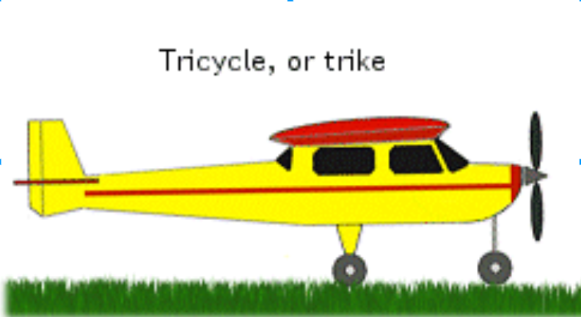
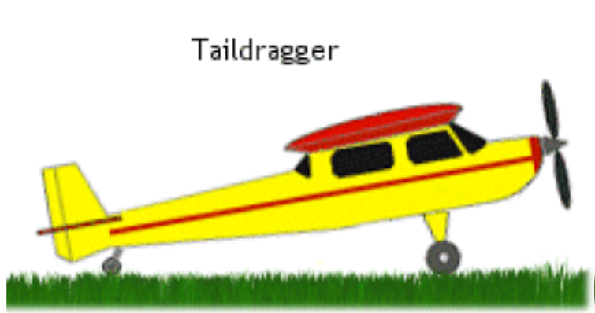
Tradeoff – Landing Gear Configuration
Tricycle
Minimize drag at T/O roll
Restoring torque of NLG when free-castoring (esp. during landing)
Maintain high AOA at touchdown
Main gear at aft-section
Possible tail/wing strike
Tail-dragger
MLG at front -> better CG
Good puller-prop ground clearance
High drag at T/O roll
Low AOA descent
Requires a pitch-up movement at landing
Conclusion → Tricycle
Minimizes drag -> T/O performance
Tricycle tends to be more stable when in yaw [ref] (MLG larger restoring torque when yaw)
Notes:
0.75 minute

Slide 16
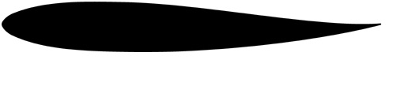
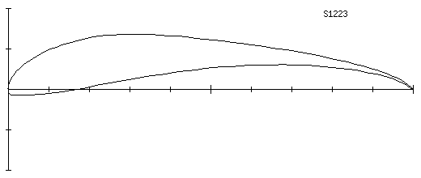
Tradeoff - Airfoil Selection
Reflex
Ease of construction
Lower lift
Reflex + High lift
Higher lift
Hard to interface
Hard to obtain elliptical lift distribution
Conclusion → Reflex Airfoil Only
Notes:
( 8 minute mark ) [lap 17 + 18]
4 minutes

Slide 17
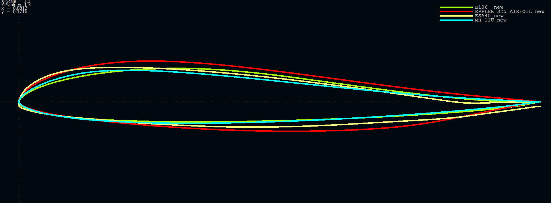
Tradeoff - Airfoil Selection
High C_{l} at selected cruise angle of attack
High lift to drag ratio
High α_{stall}: stall angle of attack
Cm₀ is positive
Higher maximum thickness

Slide 18
Tradeoff - Airfoil Selection

Slide 19
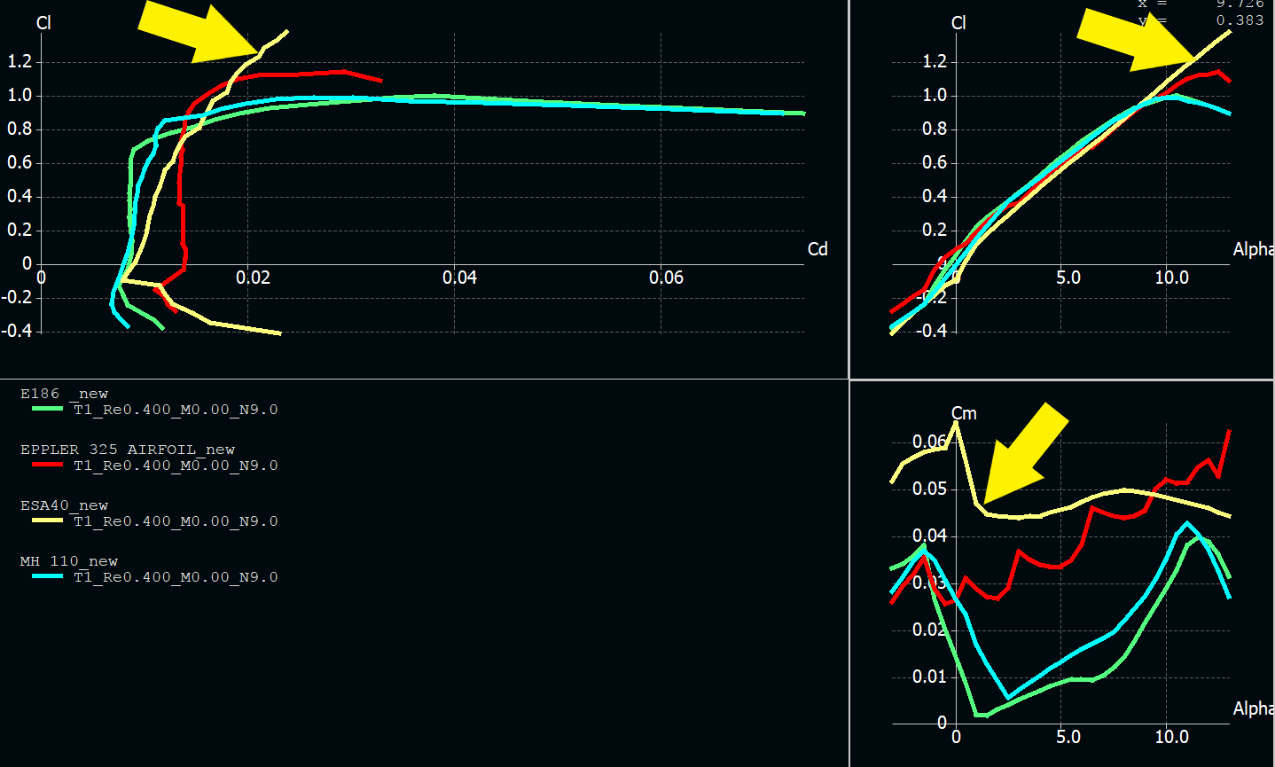
Tradeoff - Airfoil Selection
Re = 400,000 (V = 12m/s)
Conclusion -> ESA 40
Highest α-stall: 15 deg.
Highest Cm0: 0.065
High lift: 0.6 @ 5 deg. AoA
Relatively low cl/cd

Slide 20
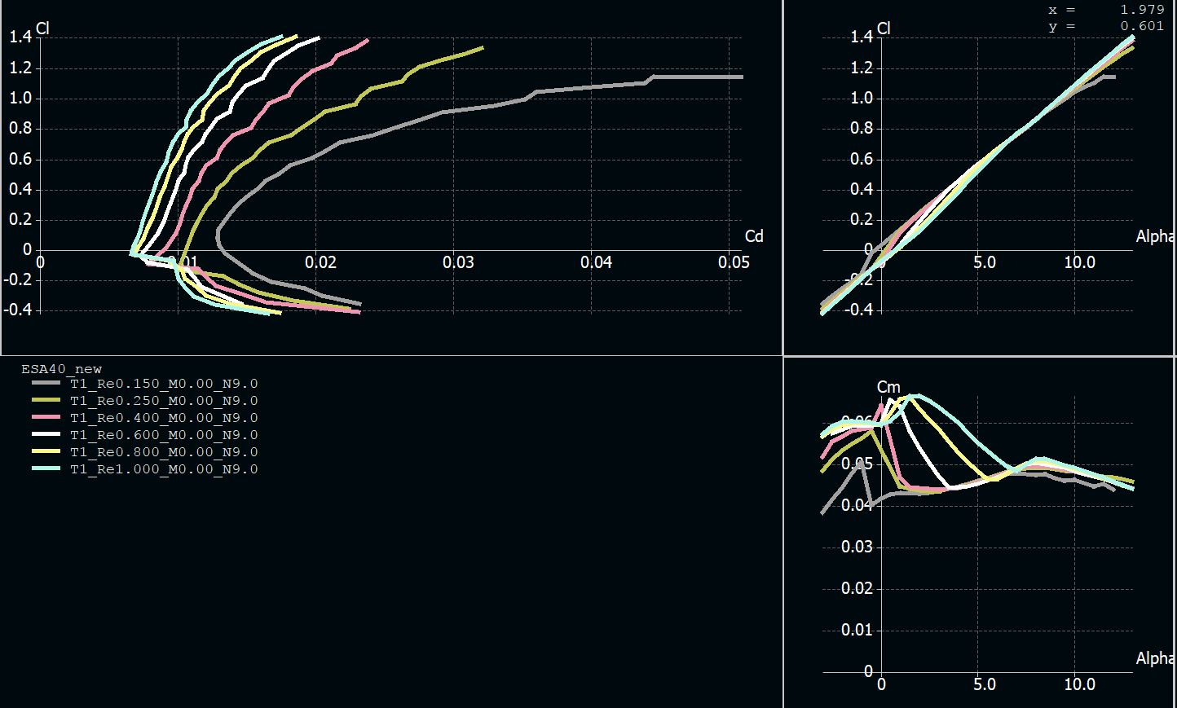
Tradeoff - Airfoil Selection
Re = 150,000 – 1,000,000
ESA40 performs consistently

Slide 21
Preliminary Design
Notes:
( 12 minute mark ) ( ~ 13min )
[Lap 17] (15 minute)

Slide 22
BWB Wing-form Parameterization
Half Central Span
Transition Span
Outer Span
Root Chord
Sweep Angle
Transition Chord
Tip Chord

Slide 23
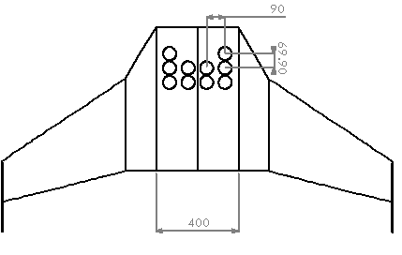
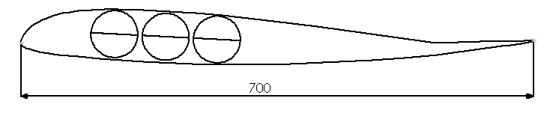
Central (Fuselage) Section
Design Variable | Root Span and Chord Length
Design Driver | Payload Volume

Slide 24
Transition Section
Design Variable | Transition Chord and Span
Design Driver | Maximize Wing Area near Root subject to BWB constraint^{[1]}
200mm
150mm
Outer Span
700mm
Sweep Angle
450mm
Tip Chord
[1] As per Prof. Grant’s specification, a BWB aircraft should have a drastic decrease in chord length (at least 30%) somewhere before half span of the aircraft over a distance similar to the change in chord length.

Slide 25
Outer Section
Design Variable | Outer Span, Sweep Angle, Tip Chord
Design Driver | Directional Stability; Sufficient Lift; Minimize CG Shift; Near-Elliptical Lift Distribution
200mm
150mm
600mm
700mm
34 deg
450mm
200mm

Slide 26
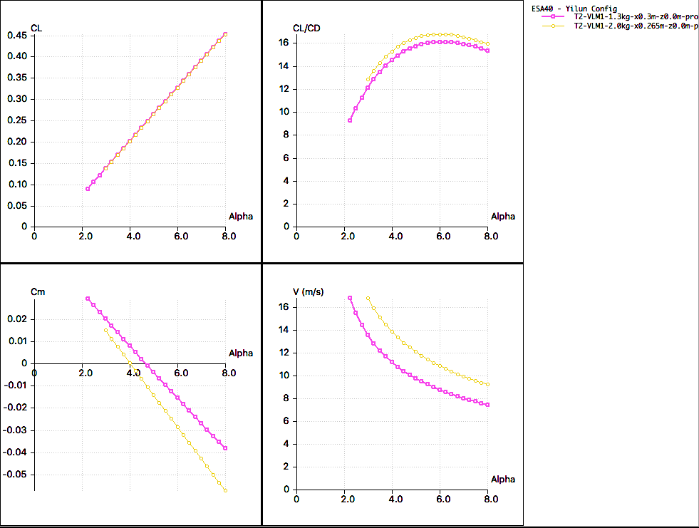

Slide 27
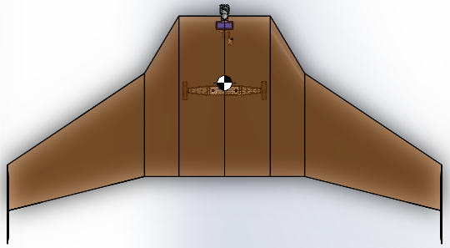
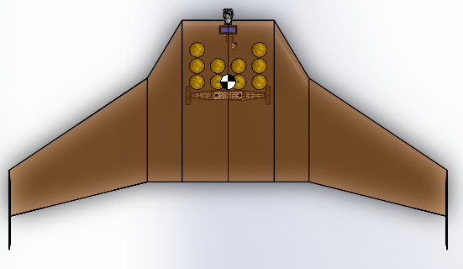
Aircraft-Payload Configurations
 | Empty Payload Configuration | Full Payload Configuration
A/C mass | 1.3Kg | 1.9Kg
CG location (margin) | 0.3m from leading edge (15%) | 0.265m from leading edge (26%)
Trim angle | 4.7 deg | 4.0 deg
Cruise Speed | 10.0m/s | 14.0m/s
Payload shifts CG forward by 0.035m (35mm)
0.30m
0.265m
0.38m
Neutral Point

Slide 28
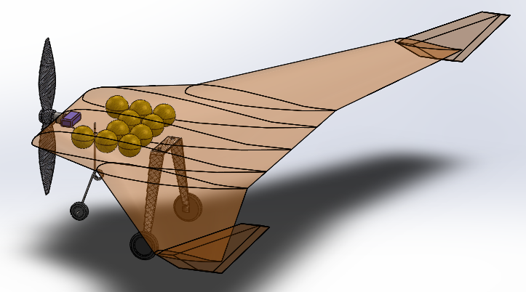
Complete Wing Specification
Total Wing Span | 1.9m
Wing Area | 0.842m²
Aspect Ratio | 4.285
MAC | 0.510m
Fuselage airfoil chord | 0.7m
C_{L} (cruise) | 0.326
C_{L} / C_{D} (Max) | 16.74
α (Optimal) | 6.0 deg
A/C Mass (Full payload) | 1967g
A/C Mass (Empty) | 1377g
Wing Loading (Full, level) | 22.1 N/m²

Slide 29
Performance
Presented by
Eric Cheng Lu
Notes:
( 18 minute mark ) Lap 20

Slide 30
Performance Highlights (Full Payload Configuration)
Parameters / Metrics | Preliminary results
Range | 11.3 km
Endurance | 21.6 minutes
Takeoff-distance(with Prop 9x6) | 8.44 meters
Power Required for Cruise | 13.8W
Minimum Thrust for level flight | 1.26N
Minimum Power for level flight | 10.88W

Slide 31
Flight Score Prediction
Flight Score = Cargo Units × f(t) × PF × TB × CB × STB + VB
= 1200 × 1.36 × 0.3 × 1 × 2 × 1.2 + 200
= 1375
Notes:
Lap 21

Slide 32
The End
Thank you! Questions?
Presented by
The flying penguin

Slide 33
Back-up Slides
Presented by
The flying penguin

Slide 34
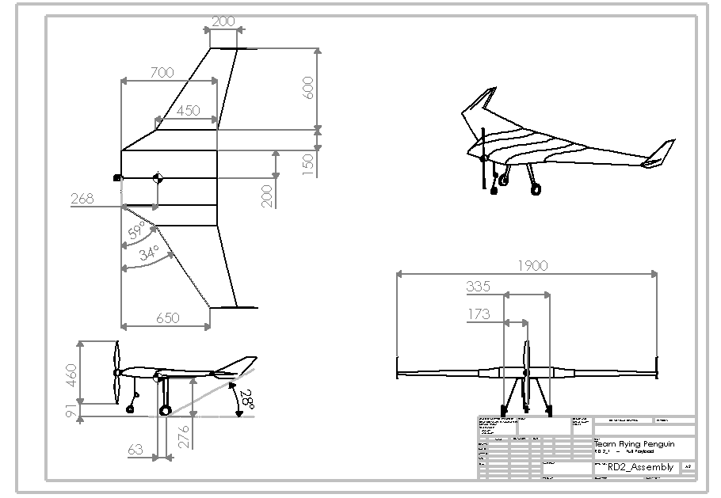

Slide 35
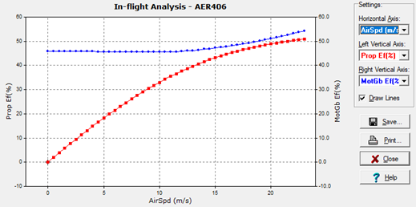
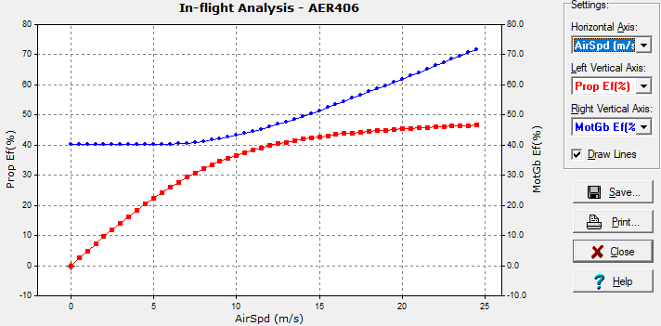
Motor Efficiency Diagrams
Prop 9x6
Prop 10x5

Slide 36
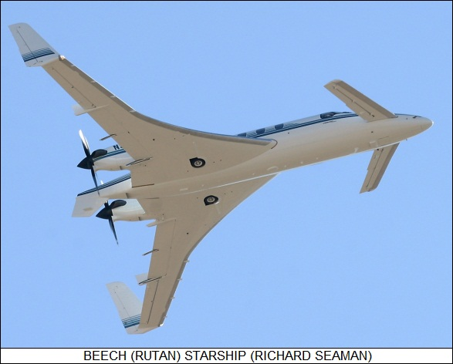
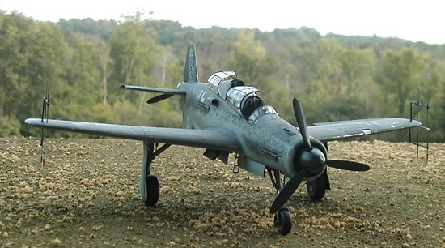
Tradeoff - Propulsion Mechanism
Pusher
Aerodynamically efficient
Avoid “prop wash”
Compromised stability
Requires long landing gears
Puller
Does not require long landing gears
Improved stability
Suffer “prop wash”
Poor takeoff performance
Conclusion → Puller
Stability is very more important than takeoff performance
Agrees with the majority of aircraft designs in

